Slide 1
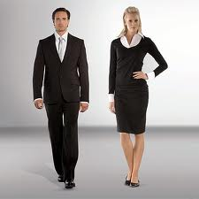
Devil is in the detail – is

Slide 2
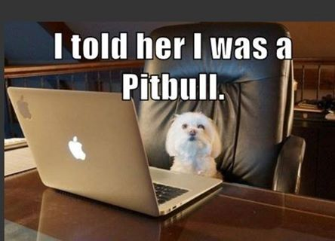
Within the first few seconds of meeting you, people form opinions & judgments based on your appearance and behaviour.
Your authenticity matters!

Slide 3
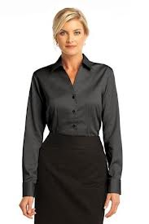
Why Bother? Open new Opportunities Career advancement Self confidence Credibility & professionalism Be remembered in a good way!

Slide 4
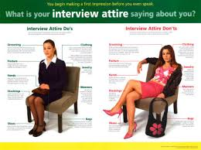
Do’s & don’t’s

Slide 5
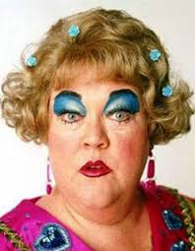

Slide 6
How do I look my best? …SECRETS REVEALED

Slide 7
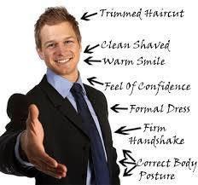
Find out the dress standard in the industry and what is their customer demographic?
Dress not for the position you have now but the one you want to have in 5 years.

Slide 8
Simple accessories
Monochromatic
All season fabrics
Avoid need for ironing

Slide 9
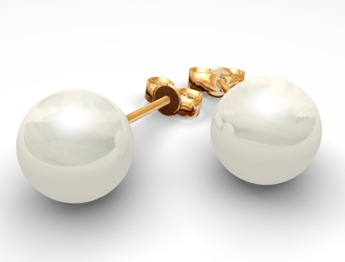
Accessories are important. Anything that dangles, moves, makes noise WILL distract attention away from you! … Less is more!

Slide 10
Wardrobe Management Strategies

Slide 11
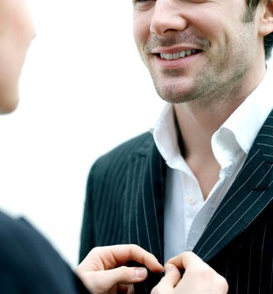
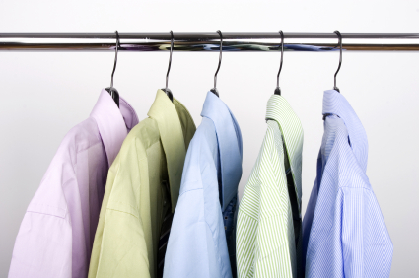
Fashion Math‘s
2 suits + 2 pants + 5 tops = 30 outfits

Slide 12
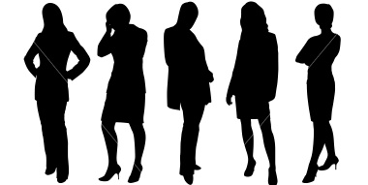
The Bare Essentials
females
a well-fitting suit
elegant top or shirt
pantyhose
leather bag
quality pen
simple accessories
conservative shoes
minimalist jewellery
males
a well-fitting suit
long sleeve business shirt
a variety of ties
quality folder or brief case
quality pen
belt
conservative shoes
dark socks

Slide 13
What image do you want to portray?
The more skin you show, the more judgments made… and you may loose credibility
Beware of plunging necklines, stiletto's; open-toe shoes, bare shoulders and exposed midriffs.
If your skirt length is more than two fingers above the knee, leave it for a night club.

Slide 14
Check that everything fits properly.
- prepare your clothes the night before & try them on… use a mirror – even call a friend!

Slide 15
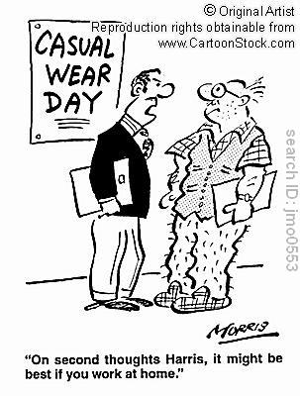
Personal Grooming

Slide 16
Sweat marks, body odour, bad breath, crushed
clothing, poor hygiene speaks louder than your
resume.
Make sure your clothes are clean, free of holes or tears, missing no buttons and not wrinkled.
Polish your shoes (yes, they will notice!)
Too much after shave or strong perfume can also deter!

Slide 17
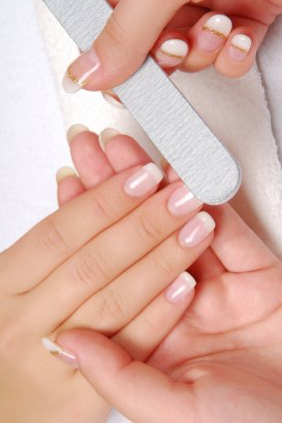
You can tell a
professional by their
hands.
Have a manicure or
do your own.
(BOYS TOO!)

Slide 18
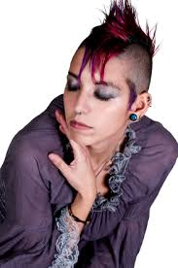
If your hair is not right, you wont look or feel your best.
Find the style that works for you. It doesn’t have to be boring, but keep it neat.
Avoid multi colours, dread locks, wild – out of the mainstream styles.
If all the employees look like this.. Then you will fit in!

Slide 19
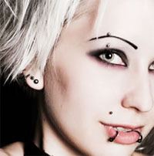
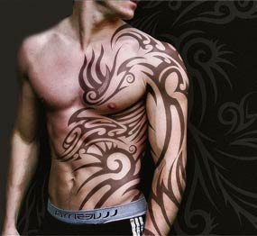
If you have piercings, leave them at home.
Cover tattoos

Slide 20
research

Slide 21
Women who wear
make-up earn 23% more than those who don't!
Girls…did you know that you’re four times more likely to get a promotion if you wear makeup?
Not too much!
Lipstick is a bare essential, and by wearing it, you create the impression that you care about your appearance.

Slide 22
Make sure your breath is fresh.
RUN THE TEST!
Freshen your breath or eat a mint before you go into a meeting.

Slide 23
To really put your best foot forward…go to bed early and get a good night’s sleep.

Slide 24
The Four Major M’s
Mirror
Material
Mother
Morals
MMMMMMMMMmmmmmmmmmmm

Slide 25
RESUMES THAT GET YOU AN INTERVIEW….
Resumes (cv) - living, working document
- review and update often
- be able to “sell” your skills, experience and your unique BRAND!
If resume is not securing interviews… then NOW is the time to GET NEW ONE!
Ask:
Expectations of role? (What do they really want? )
Why is position available?
“What does of 80 % of the day in this role look like?”
What sort of person are they looking for?
Don’t rave about yourself yet... Be 100% interested in them & the role
(if it’s an email or on-line application – READ for an instructions carefully…)

